Slide 1
Counterfactual Explanations
E.g., Peter applied for a loan and got rejected. He wonders why?
If Bank has allowed transparency, it could’ve used Counterfactual explanations
Changing the values of factors of Peter’s example we can tell whether the loan gets accepted if Peter had earn another 1000 dollars in income, or if he had fewer credit card defaults, etc.

Slide 2
Counterfactual – Multiple stories
Counterfactuals can have multiple stories
One counterfactual might say to change the feature value A
Other counterfactual might say to leave A unchanged and change the value of B
Need to evaluate counterfactuals and select the best one

Slide 3
Counterfactual – Evaluation
A good counterfactual would have
A counterfactual instance would produce the predefined prediction as close as possible
A counterfactual should be as similar as possible to the instance regarding feature values
A counterfactual should change as few features as possible
A counterfactual should have feature values that are likely

Slide 4
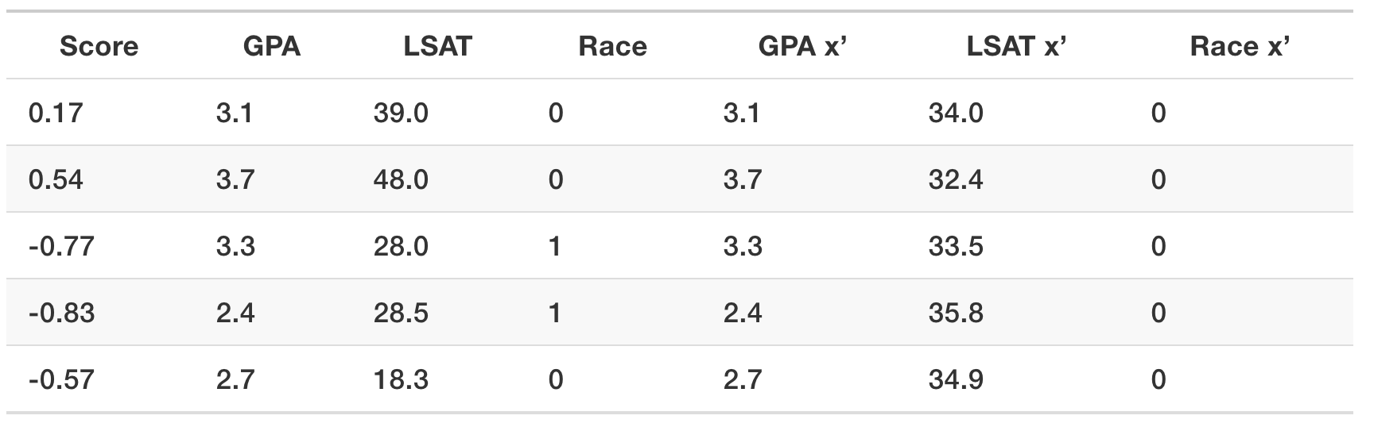
Counterfactual - Example

Slide 5
Counterfactual Explanations
Advantages
Interpretation is very clear
Doesn’t require access to data or model
Works with systems that do not use machine learning
Relatively easy to implement
Disadvantages
For each instance, multiple counterfactuals can be found
No guarantee for a given tolerance a counterfactual can be found
Does not handle categorical features with many levels
Lacks a general software implementation

Slide 6
Prototypes and Criticisms
A prototype is a data instance that is representative of all of the data
A criticism is a data instance that is not well represented by the set of prototypes
Purpose of criticism is to provide insights together with prototypes, for data points which the prototype do not represent well
Both prototypes and criticisms are actual instances from the data

Slide 7
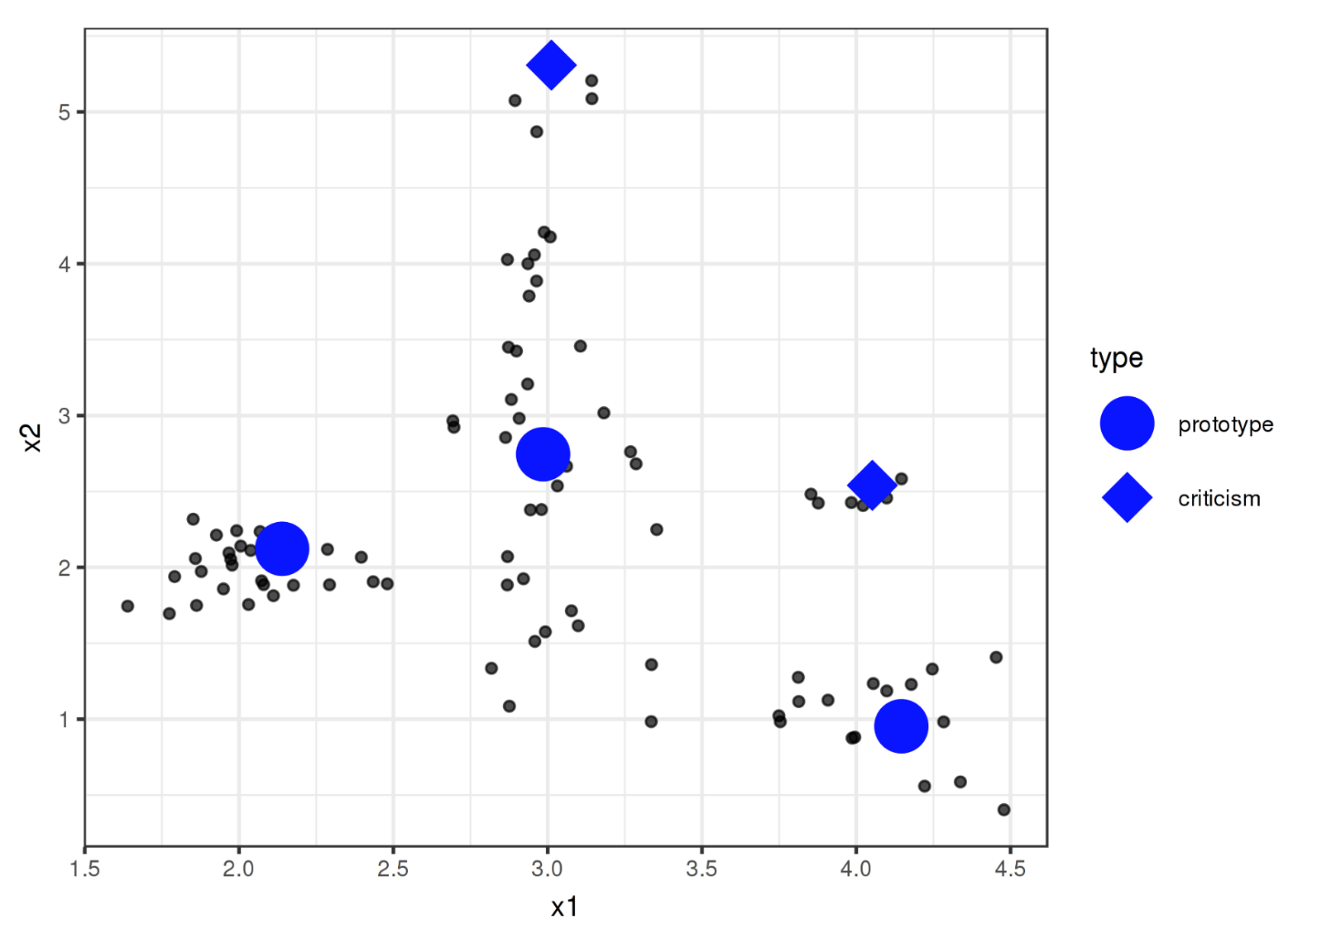
Prototypes and Criticisms

Slide 8
Prototypes and Criticisms
Finding prototypes
Any clustering algorithm that returns actual data points as cluster center would qualify for selecting prototypes
E.g., k-medoids - a variant of k-means clustering
Finding Criticisms
MMD-Critic developed by Kim et. al. (2016) combines finding prototypes and criticisms in one framework
MMD-Critic compares the distribution of data and distribution of prototypes
MMD-Critic selects prototypes that minimize the discrepancy between two distributions
Data points in areas with high quality are good prototypes
Data points from areas not explained by prototypes are selected as criticisms

Slide 9
Prototypes and Criticisms
Using Prototypes and Criticisms we can analyze the predictions
In which cases was the algorithm wrong?
We have a number of examples that represent the data distribution well and would help us find out weaknesses of ML models
Google had built an image classifier that identified black people as ”gorillas”
Even if the model is 99% accurate, it may go wrong in the remaining 1%
One possible validation: Randomly check some 1000 images. (Highly unlikely to capture that 1%)
Using Prototypes and Criticisms we would have samples representing the data distribution and can provide better validation of ML models

Slide 10
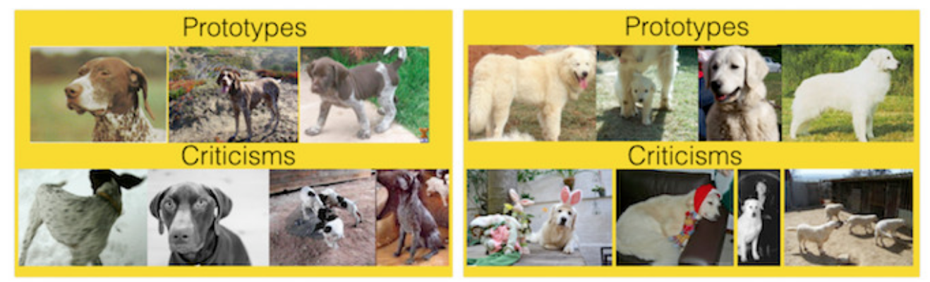
Prototypes and Criticisms
Image Classification Task: Classify images of dog into breeds

Slide 11
Prototypes and Criticisms
Advantages:
Free to choose the number of Prototypes and Criticisms
Works with any type of data and any type of ML model
Easy to implement
Disadvantages
Choose the number of Prototypes and Criticisms
Selecting the hyper-parameters of MMD Critic to select Prototypes and Criticisms
Disregarding the fact that some features may not be relevant

Slide 12
Influential Instances
Machine Learning models are a product of training examples
What if deleting one of the examples would impact our model?
We call that example “influential” when deleting it impacts the model parameters and predictions
By identifying influential training instances, we can debug machine learning models and better explain their behaviors and predictions

Slide 13
Influential Instances
Two approaches for identifying influential instances
Deletion diagnostics
Influence Functions
Both approaches are based on robust statistics less affected by outliers or violations of model assumptions

Slide 14
Influential Instances
Example: Imagine you are estimating the average income of people in your city and ask 10 random people
Apart from the fact that, the sample is probably bad
How much is your estimate influenced by a single person?
Recalculate the mean by omitting individual answers or
Derive mathematically via “influence functions” how the mean value can be influenced

Slide 15
Influential Instances
Deletion Diagnostics
Recalculate the mean value ten times, omitting one of the income statements each time
Measure how much the mean estimate changes
A big change means the instance is influential
Influence Function
Upweights one of the persons by an infinitesimally small weight
Weight is corresponding to the first derivative of the model

Slide 16
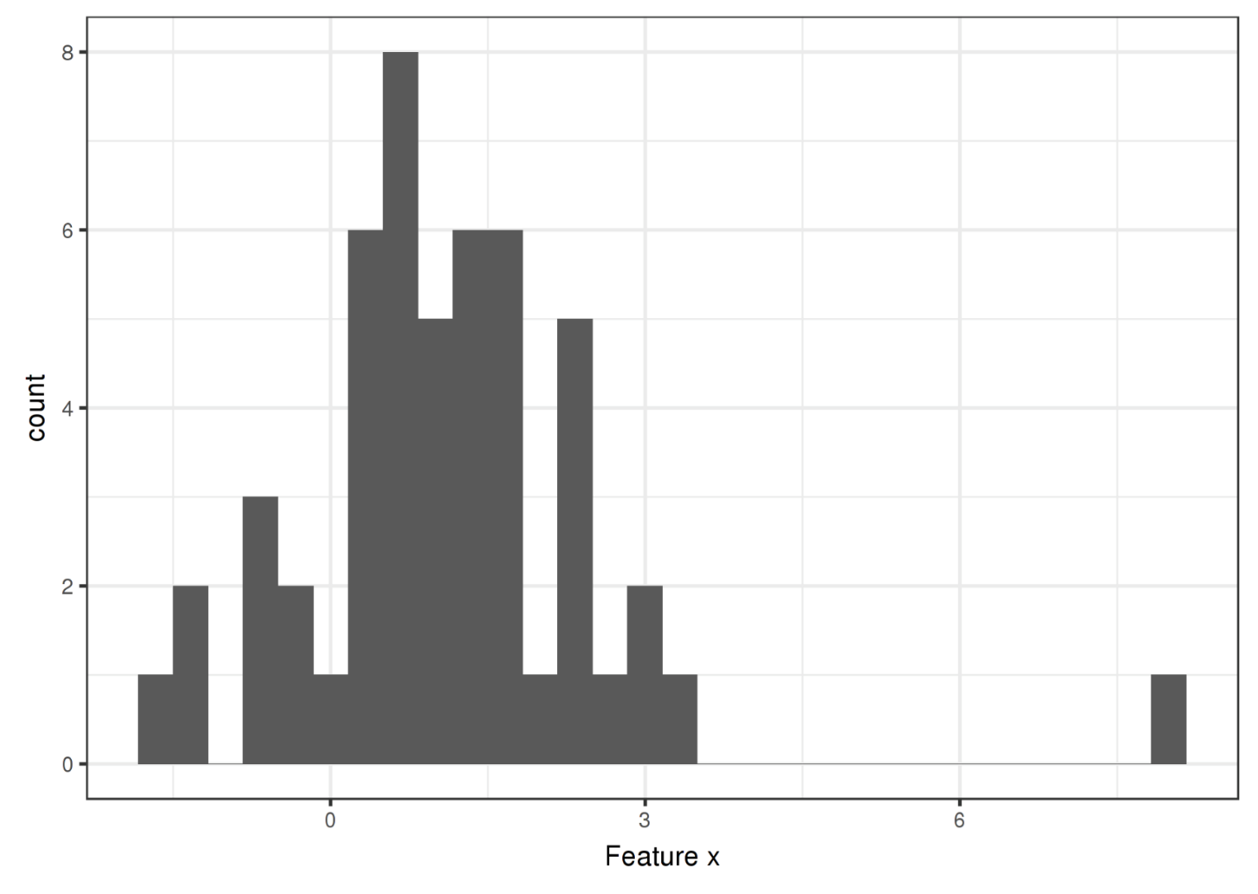
Outliers

Slide 17
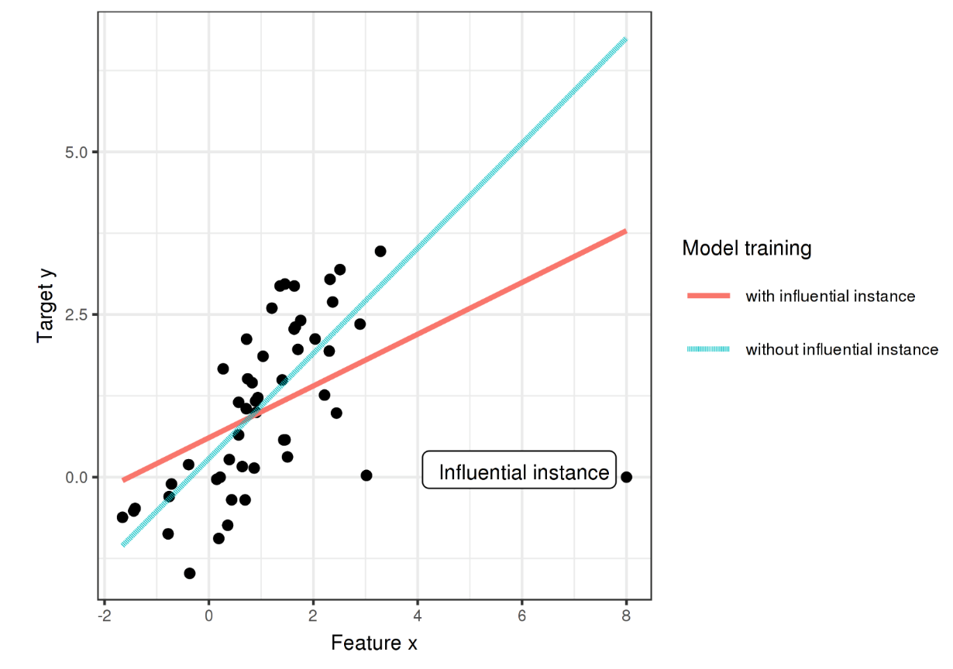
Influential Instances

Slide 18
Why does Influence Instances help?
We ask how the model parameters or the predictions would change if we removed instances from the training data in the training process
With influential instances, we do not treat the model as fixed, but as a function of the training data
Influential instances help us answer questions about global model behavior and about individual predictions
Which were the most influential instances for the model parameters or the predictions overall?
Which were the most influential instances for a particular prediction?
Which training instances should be checked for errors and give an impression of the robustness of the model?
We might not trust a model if a single instance has a strong influence on the model predictions and parameters

Slide 19
Deletion Diagnostics
Lets say, SVM model is built to predict cervical cancer given risk factors
Measures which training instances were most influential overall and for a particular prediction
As prediction is a classification, the influence is measured as the difference in predicted probability
An instance is influential if the predicted probability strongly increases or decreases on average in the dataset when the instance is removed from model training

Slide 20
Deletion Diagnostics
Total samples: 858; Need to build 859 models
The most influential instance (540th) has an influence measure of about 0.01
An influence of 0.01 means that if we remove the instance, the predicted probability changes by 1%
Quite substantial as the average predicted probability for cancer is 6.4%
And mean influence measure over all instances is 0.2%
The influential instances are the first ones that should be checked for errors

Slide 21
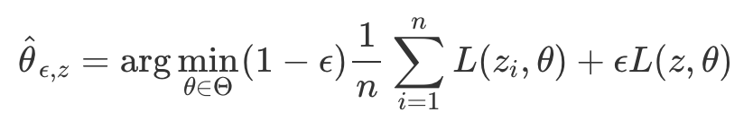
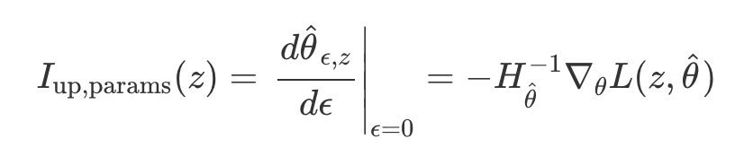
Influence Functions
Alternative to Deletion Diagnostics for identifying influence instances
In Deletion Diagnostics, if we had X training samples, we need to build X+1 models
Takes a lot of time when working with complex models like Deep Learning
Instead, Influence Functions approximate how much the model changes when the instance is upweighted in the empirical risk (sum of loss over training data)
It requires access to the loss gradient w.r.t. the model parameters

Slide 22
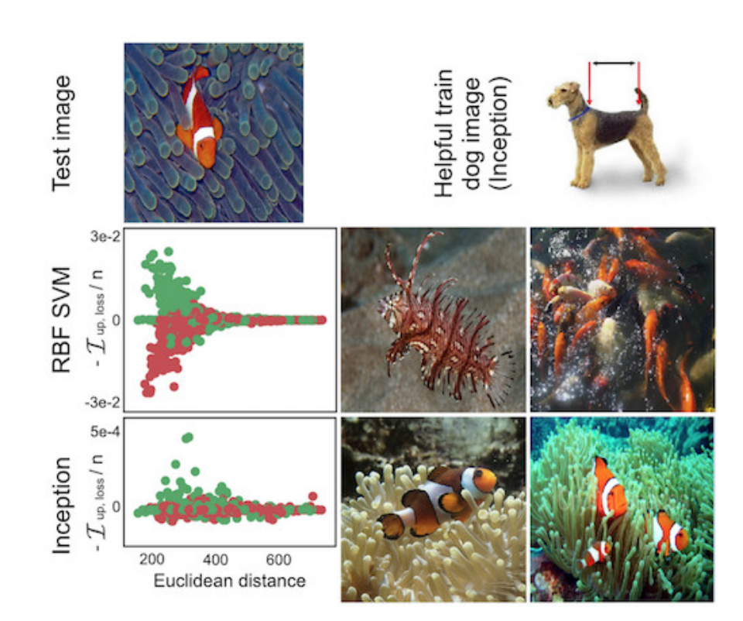
Influence Functions
Understanding model behavior
Each model have different ways of making predictions even if they have similar performance
Understanding the particular weaknesses of a model by identifying influential instances helps to debug

Slide 23
Influence Functions
Handling domain mismatches / Debugging model errors
Domain mismatch means that the distribution of training and test data is different, which can cause the model to perform poorly on the test data
Influence functions can identify training instances that caused the error.
E.g,. A prediction model for the outcome of patients who have undergone surgery. All these patients come from the same hospital.
Now you use the model in another hospital and see that it does not work well for many patients.
Take a patient who had a false prediction
Find and analyze the most influential instances using influence functions
For example, this could show that the second hospital has older patients on average
The model simply lacked the data to learn to predict this subgroup well.

Slide 24
Influential Instances
Advantages
Deletion diagnostic is model agnostic
Influence functions via derivatives can also be used to create adversarial training data.
Disadvantages
Deletion diagnostics are very expensive
Influence functions are a good alternative but only for models with differentiable parameters
Influence functions are only approximate
No clear threshold on calling an instance influential

Slide 25
Thank You!

